Slide 1
Nvidia ecosystem and how Futurewei supports it

Slide 2
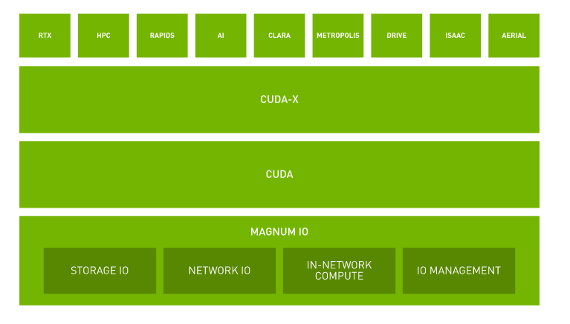
Optimization stack
APP/data engine/AIML pipeline
ML, DL libraries and tools based on CUDA.
Multi-core, multi-thread programming library that supports vector optimization.
Source: https://www.nvidia.com/en-us/data-center/magnum-io/

Slide 3
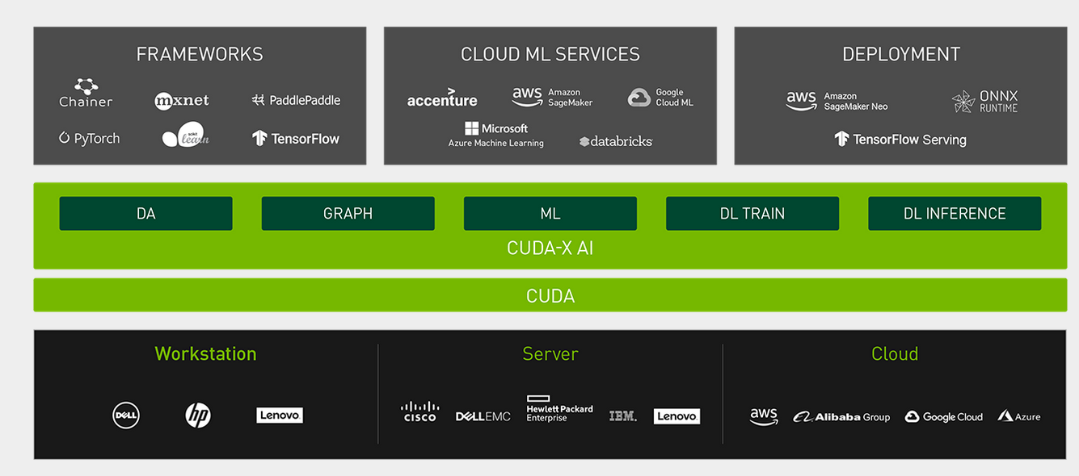

Source : https://developer.nvidia.com/blog/accelerating-io-in-the-modern-data-center-magnum-io-architecture/
Telemetry and troubleshooting across compute, network, and storage layers.
Cumulus NetQ, Mellanox UFM
The GPU bypasses the CPU and system memory, and accesses remote storage via 8X 200 Gb/s NICs, achieving up to 1.6Terabits/s of raw storage bandwidth.
NVIDIA NVLink® fabric and RDMA-based network IO acceleration reduces IO overhead, bypassing the CPU and enabling direct GPU to GPU data transfers at line rates
Offloading to “network processors”.
Bluefield DPU, MPI tag matching, Mellanox SHARP
GPUDirect, Mellanox NVMe SNAP
DPDK, GPUDirect RDMA, HPC-X, NCCL, NVSHEM, UCX, ASAP

Slide 4
Software ecosystems from Nvidia
NGC registry
http://ngc.nvidia.com
Containers, models, pipelines for Nvidia GPUs.
GDS (GPU Directed Storage)
https://developer.nvidia.com/gpudirect-storage
A GDS-compliant file system must be used.

Slide 5


Target #1: DGX-2 Storage reference architecture (Depending on the collaboration with Nvidia and budget)
…
DGX-2 systems
A quick assembly of the components will yield a rack loaded with two DGX-2 systems.
IB or Ethernet
Storage

Slide 6
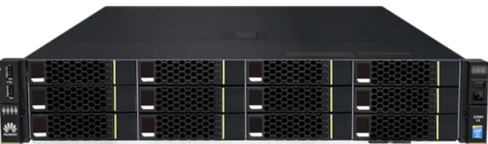
Target #2: GPU-heavy cluster (DGX-2 like) storage reference architecture (less dependent, less expensive)
…
Servers loaded with Tesla GPUs
A quick assembly of the components will yield a rack loaded with GPU-heavy servers and storage, connected by RoCE or IB network.
IB or Ethernet
Storage

Slide 7
Common data solution reference architecture (open-source)
Software
Configuration
Common
Vertical (ADAS, BIO) training
ADAS
Simulation
Data lake
AI
HPC
Apollo
Jupyter hub
BDD 100K
Erdos
Python3
GPU monitoring
BigBench v2
TPC-DS
Horovod
Ray
Keras
CARLA
test-suite-ohpc
GPU scheduler?
Flink
Spark Stream
Spark SQL
Spark ML
Pytorch
openHPC
Docker
Presto
Spark core
TensorFlow
Prometheus
Hive
Alluxio
K8S
Grafana
Java
Nvidia container runtime
Kafka
GCC
MySQL
CUDA-X
Argo workflow
Scala
CUDA
Host 1
Host n
Remote storage
System
Configuration
NVMe driver
AWS
GPU
GPU
GPU
GPU
LUNs
GPU driver
Files
Azure
NFS
Objects
Google Cloud
Multi-GPU NVlink
Multi-GPU NVlink
NIC
NIC
NIC
Extended solution
Multi-host connected by high speed RDMA network (IB/RoCE)
Connect to storage with NVMe over Fabric (IB/RoCE)

Slide 8
Benchmark selection/adoption
Need to have storage needs (large data sets, IO bound, etc)
Candidates
BDD100k (ADAS related) (2TB)
Simulation and visualizing NASA Mars Lander data set (128TB)
Simulate, analyze, and visualize molecular dynamics dataset (17TB)
TPCx-BB express benchmark BB (Hadoop based big data system), IO intensity queries.
TPC-H
GDS for PyTorch (GDS numpy, GDS numpy DALI, GDS numpy 1-file with DeepLabv3+), on CAM5 climate data set to predict extreme weather patterns.

Slide 9
Nvidia GPUDirect Storage (GDS) support, v0.9 Nov 2020
Storage node having front-end NVMe over Fabric block support
Tesla GPU
Block service
libcufile.so
NIC
User space
CUDA 11.0
Mode 1: “NVMeoF with ext4”
Nvidia-fs.ko
Kernel space
Ext4 FS
NFS mount
/dev/nvme0
NIC
IB or RoCE switch
(remote)
/dev/nvme1
Storage node having front-end NFS over RDMA support
Local NVMe drive
File service
NIC
Mode 0: local NVMe drive
Mode 2: “NFSoRDMA”
Source: https://developer.nvidia.com/gpudirect-storage, Key features: for local NVMe with ext4, NVMeoF with ext4, NFSoRDMA

Slide 10
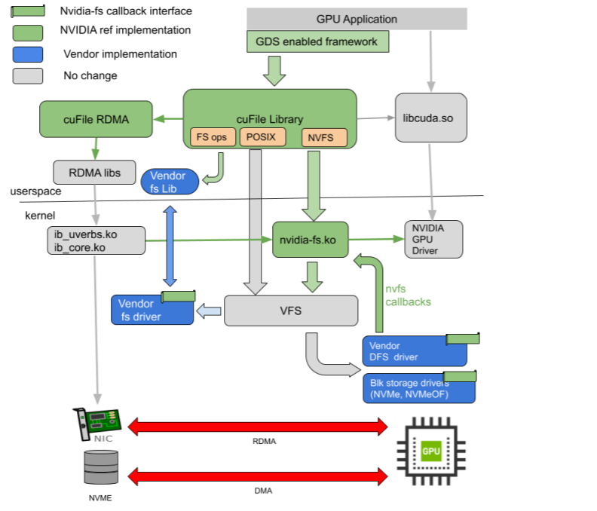
Reference numbers in the industry:
DGX-2 Non-GDS: <40GB/s with high CPU util. rate
DGX-2 GDS: 53GB/s with 16 drives
WekaIO GDS: >80GB/s
Vast GDS: >90GB/s peak
Source: https://blocksandfiles.com/2020/10/12/wekaio-nvidia-gpudirect-benchmark/
https://blocksandfiles.com/2020/07/23/nvidia-gpudirect-storage-software/
Some vendors may choose to use special DFS drivers.
Our initial approach. Later on we can look into pros and cons.
Source: Webinar: NVIDIA GPUDirect Storage: Accelerating the Data Path to the GPU
https://info.nvidia.com/gpudirect-storage-webinar-reg-page.html?thankyou=true&aliId=eyJpIjoiNHNZQVdNQkhoRWs3UE1zOCIsInQiOiJxWnRJWitnWUhLUFBWVjFOZW1EdlZRPT0ifQ%253D%253D&ondemandrgt=yes
https://on24static.akamaized.net/event/24/01/05/4/rt/1/documents/resourceList1594683598315/gdsq320webinar1594683596098.pdf

Slide 11
Part 1: Single host environment with GDS
Single-host “DGX” simulation installation
Not including all the AI/ML methods but include a training example.
Not including k8s (GPU scheduling) but include basic containers using Nvidia container runtime.
Not including remote storage connection
GDS Mode 1 testing with simulated storage devices
Not using real OceanStor v6 (not available)
GDS Mode 2 testing with simulated storage devices
Not using real 100D (no real NVMeoF NAS available to us) or OceanStor v6
Single-host configuration wrap up with deliverables
Initiate collaboration with Nvidia for DGX-2

Slide 12
Part 2: Distributed, multi-host, multi-tenancy environment and best practice
Distributed, Multi-GPU host configuration need more cards, more investment.
Challenges include GPU scheduling
multi-tenancy and GPU aware
GPU aware K8s
VM environment (whether it’s popular, vmware solution)
Performance evaluation
Different scheduling methods in a cluster environment
Different GDS modes
Different AI workloads

Slide 13
Part 3: Market & use case research
Use case investigation
Potential customers and possible use cases
For example, oil companies.
RFI analysis related to AI intelligent systems
EMEA market
Future RFI answering
Analysis for current and future market

Slide 14
Deliverable#1 Published Paper for Futurewei’s data platform solution
Including support for GPU heavy system like DGX-2
GPUDirect support
Reference architecture using Huawei equipment
Some performance / benchmark numbers, based on open source
Benchmark selection
Tuning guideline based on benchmark workload requirement for storage
Comparison between different GDS modes
Market analysis for AI intelligent systems.

Slide 15

Deliverable#2 Open-source config scripts
infra
Ansible
VMs temporarily not supported
host1
common
inventory
host2
datalake
ai
adas
playbook
hpc
Plan to create very basic ansible steps and test programs as open-source projects.
Could release as part of project Caerus.

Slide 16
Deliverable#3 Nvidia Eco System Collaboration
Explore the possibilities to become a Nvidia partner as storage vendor
Working in-progress
May need company executive level supports

Slide 17
Deliverable#4 Published Paper - PayU model based ADAS Solution
Work with EU team to have a PayU based solution
ADAS solution based on current and near future products
ADAS storage key requirements
Need company multi-department level collaborations and supports.

Slide 18
Deliverable#5 Published Paper for Futurewei’s Open Source Based Big Data platform solution
Reference architecture using Huawei equipment
Some performance / benchmark numbers, based on open source
Benchmark selection
Tuning guideline based on benchmark workload requirement for storage
Market analysis for Bigdata intelligent systems.

Slide 20
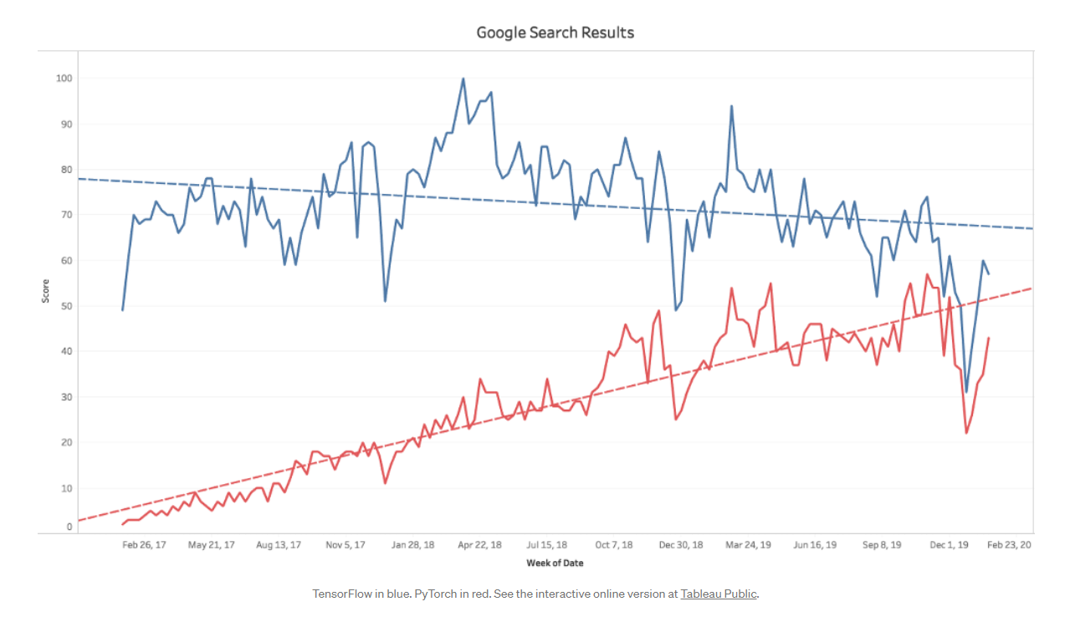
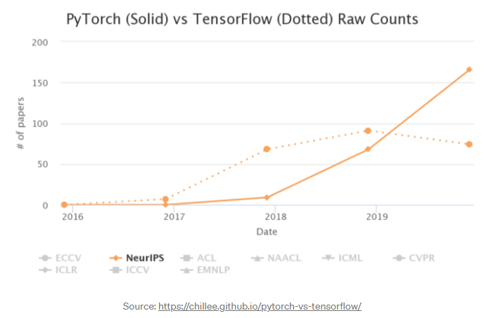
AI software ecosystem
In 2020, TensorFlow has a narrow edge over PyTorch. But in research field, researcher prefer Pytorch over TensorFlow.
Our CDS environment is built upon both TensorFlow and Pytorch.

